Slide 1
Spanish I
Pronombres sujetos y el verbo ser
(Subject Pronoun and Ser Verb)

Slide 2
Subject pronoun and Ser Verb
Subject Pronoun
Ser Verb (To Be)
¿Quién eres tú?

Slide 3
Subject pronouns
A pronoun is a word that takes the place of a noun.
Ex- Bob is swimming. He is swimming.

Slide 4
What are the English subject pronouns?
 | Singular | Plural
1st person | I | We
2nd person | You | You (all)
3rd person | He, She, It | They

Slide 5
English subject pronouns and their Spanish equivalents
Spanish subject pronouns are similar to English, but there are some differences.
 | Singular | Plural
1st person | I = Yo | We = nosotros (m) Nosotras (f)
2nd person | You (familiar) = tú | You (familiar) = vosotros vosotras
3rd person | He = él She = ella You (formal) = Usted | They (masculine) = Ellos They (femenine) = Ellas You all (formal) = Ustedes

Slide 6
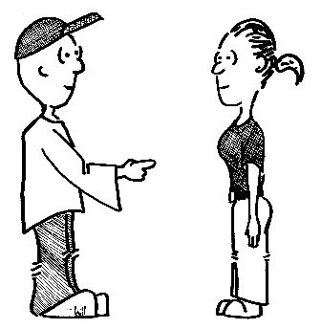
YOU, You, and You
In English, there is only one way to express “YOU”
In Spanish there are 2 ways to express “you”
tú
usted

Slide 7
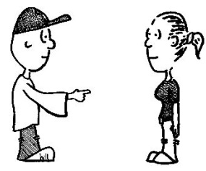

Difference: Tú vs. Usted
Tú = you (informal/familiar)
Use “tú” when talking to people with whom you are on a first name basis.
friends
family
small children
people younger than you
pets
Usted (Ud.) = you (formal)
Use “Usted” when talking with people to whom you should show respect.
People in authority (police, teachers, bosses, etc.)
Strangers
Acquaintances
Adults

Slide 8
New vocabulary
Chico/Chica- Boy/ Girl
Chicos/ Chicas- Boys/ Girls
Estudiante - Student
Inteligente- Intelligent
Alto/Alta- Tall
Bajo/Baja- Short
Guapo/Guapa- Handsome/ Beautiful
Listo/Lista- Smart
Aburrido/Aburrida- Boring

Slide 9
Subject + Verb
Yo
Tú
Él
Ella
Usted
Nosotros/as + Ser
Vosotros/as
Ellos
Ellas
Ustedes

Slide 10
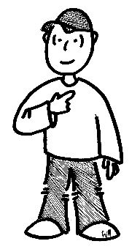
“Yo” + “Soy”
“Yo” means “I”
Yo soy chico/a
Yo soy estudiante (student).
Yo soy alto (tall).
Yo soy alta.
Yo soy listo (smart).
Yo soy Amit
¿Quién eres tú?
¿Qué eres tú?

Slide 11
“Tú” + “Eres”
Tú means you (familiar/ informal)
Tú eres Maria.
Tú eres inteligente.
Tú eres estudiante.
Tú eres guapa.
Tú eres alta.

Slide 12
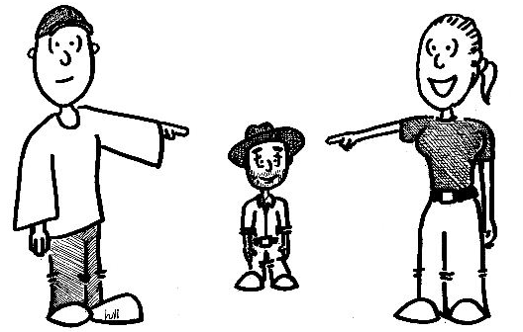
“Él” + “Es”
Él means He
It is used when talking ABOUT a boy/man.
Jorge es mexicano.
Él es chico.
Él = He El = The

Slide 13
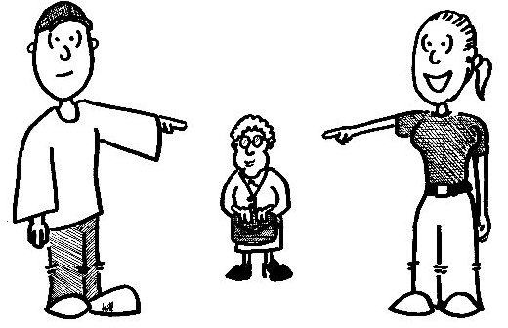
“Ella” + “Es”
Ella means she.
It is used when talking ABOUT a girl/woman.
Rosa es mexicana.
¿De dónde es ella?- Ella es de Acapulco.
Ella es baja.
Ella es gorda
Ella es chica

Slide 14
“Usted (Ud.)”+ “Es”
Usted means You (formal)
Considered a 3rd person singular pronoun for verb conjugation, but it is a 2nd person pronoun.
Usted es María.
Usted es colombiana.

Slide 15

“Nosotros/Nosotras”+“Somos”
Use nosotros/nosotras to talk about a group of people that includes you.
In Spanish, we distinguish between “we” masculine and feminine:
Nosotros somos guapos
Sangeet y yo somos chicos.
Maria y yo somos guapas
(Abhishek y yo= nosotros)
Yo y Abhishek
Y= and

Slide 16
“Vosotros/Vosotras”+“Sois”
Vosotros/vosotras are the plural forms of tú.
Vosotros is used when talking to a familiar group of males or a mixed group.
Vosotras is used when talking to a familiar group of females.
Vosotros sois inteligentes.
Vosotros sois chicos.
Vosotras sois chicas.
Vosotras sois mexicanas.
(Atul y tú= Vosotros) sois indios.

Slide 17
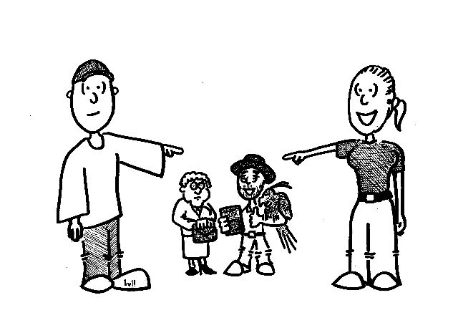
“Ellos”+ “Son”
Ellos = They (masculine)
It is used when talking ABOUT a group of boys/guys/men or a mixed group.
Ellos son mexicanos.
Ellos son inteligentes.
Pablo y Juan son colombianos.
Rahul y Ankita son estudiantes.

Slide 18

“Ellas” + “Son”
Ellas = They (feminine), Remember ll= y sound.
It is used when talking ABOUT a group of only females.
Ellas son mexicanas
Ellas son guapas
Sukriti y Michelle son altas

Slide 19
“Ustedes” + “Son”
Ustedes means You all (formal)
Considered a 3rd person plural pronoun in verb conjugation but it is second person plural.
Ustedes (male or female)
Ustedes son peruanos.
Ustedes son Maria y José.

Slide 20
Subject Pronoun and Ser Verb
Yo soy
Tú eres
Él/ Ella/ Usted es
Nosotros/ Nosotras somos
Vosotros/ Vosotras sois
Ellos/ Ellas/ Ustedes son

Slide 21
¿Quién eres?/ Who are you?
Yo soy Shilpi
Yo soy chica
Yo soy estudiante
Yo soy alta
Yo soy guapa

Slide 22
Summary
Subject Pronoun (Pronombres Sujetos)
Ser Verb and its Conjugation (El Verbo Ser)
¿Quién eres tú?

